Slide 1
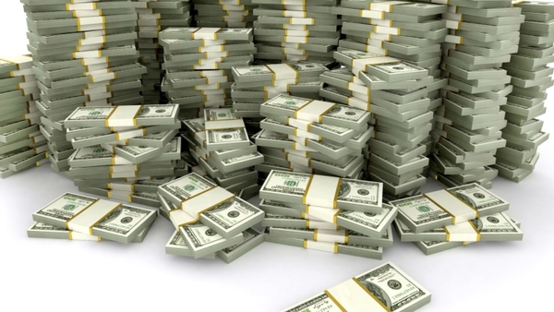
Tax Smart Gifting Strategies for 2025
McLeod Health Foundation &
Eastern Carolina Community Foundation
James E. Connell FAHP, CSA
Charitable Estate and Gift Planning Specialists
P.O. Box 3335, Pinehurst, NC 28374
Email: james@connellandassoc.com
Internet: www.connellandassoc.com
Phone: 910-295-6800
Presentation on internet - www.connellandassoc.com/currentevents.html

Slide 2

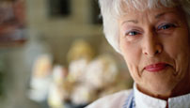


Quotes for today
80% of Americans engage in charitable giving each year.
$557.16 billion gifted in 2024: Individuals 67%, bequest 8%, balance from corporations and foundations
Average age 64,women 64%, gift $3,296
Philanthropists come in all shapes, sizes and wealth.
Which charity is part of your life story?
Notes:
Americans give for many reasons.
Studies have shown there are primary motivators for how individuals gift and they fall into 7 major categories.
Communitarians give because they have made their money in a community and want to improve the life of those in the community.
Devout individuals primarily give to religious organizations based on their faith, beliefs and values.
Investors give based on a business orientation to maximize the personal and financial benefit of their gifts.
Socialites giving is based on a party or event that raises support for charity.
Repayers give based on their experience with a charity, ie education, health care, red cross for veterans.
Altruists give from their heart because it feels good to help others.
Dynasts are giving what others have left them to distribute in a trust, donor advised funds or family foundation. They may not support the type of charities their parents did.
Many have multiple motivations.

Slide 3
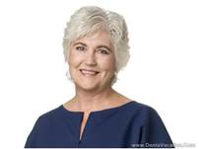

Charitable gifting taxes – Question????
Sally a single person, age 68, makes a $5,000 cash gift to CHARITY in memory of her deceased husband, age 76.
What deduction will Sally receive?
Will the gift be deductible on her 2025 Federal income tax return?
  Yes
  No
  Maybe

Slide 4
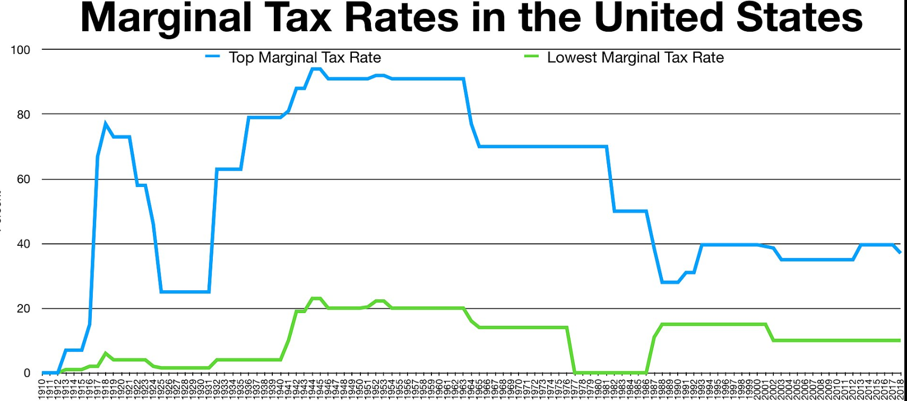
1944

Slide 5
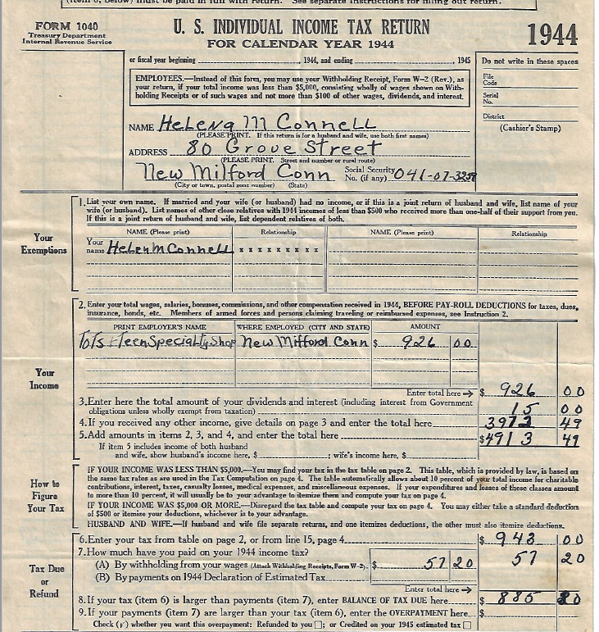
Standard
Deduction
$500
19% tax

Slide 6
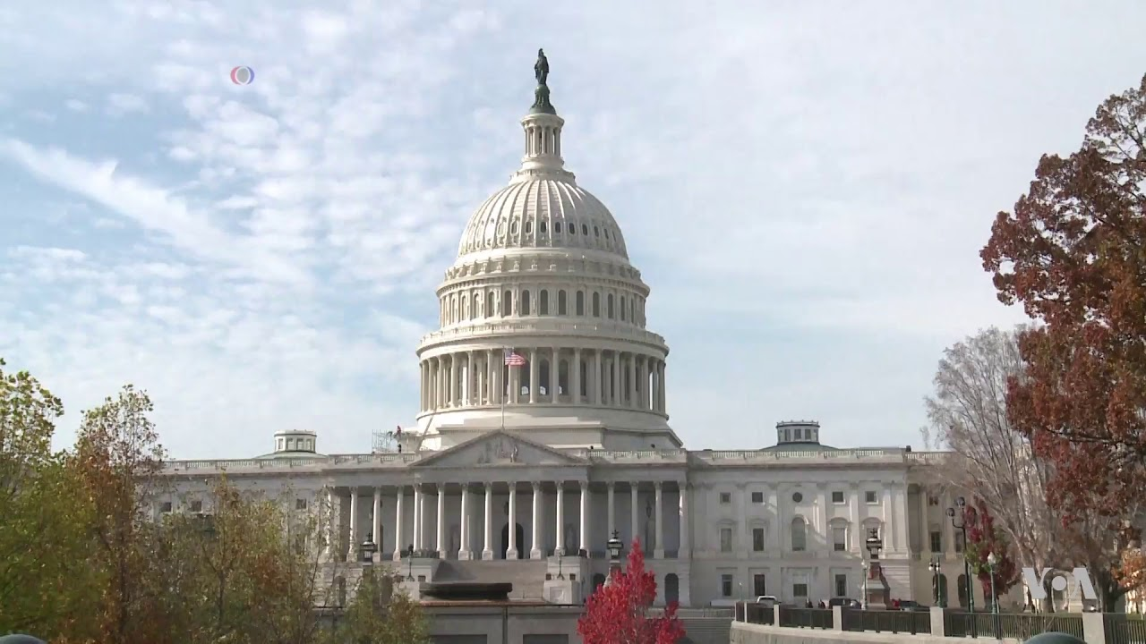
Life events with tax consequences
Earn Income
Sell Asset
Death
Give Property
Filing status, age, income, assets, net worth
Notes:
TAX EVENTS
We all will experience a number of events during our lifetimes that result in taxation. For example, if we earn income this year and decide that we are not going to be a tax protester and go to jail, then we will surely pay income taxes. Perhaps some of you here have invested in an asset and that property has increased over the years. If you sell that property, you will pay a fairly substantial capital gains tax.
Some year you might decide to give property to family members. Gift taxes are very frequently not understood well by most people. A person once commented to me, "You mean I can pay income tax when I earn something, invest it and pay capital gains tax when I sell, and then if I want to give it to my children, pay an additional tax on that same property?"
And the answer is "yes." If property is gifted in excess of the annual exclusion per year, intended to cover birthday gifts and other smaller gifts, then there could even be a gift tax.
Finally, when we pass away there could be a tax at death. Estates over the exemption equivalent pay an estate tax. In some cases, more than one-third of the estate is lost due to estate taxes.

Slide 7
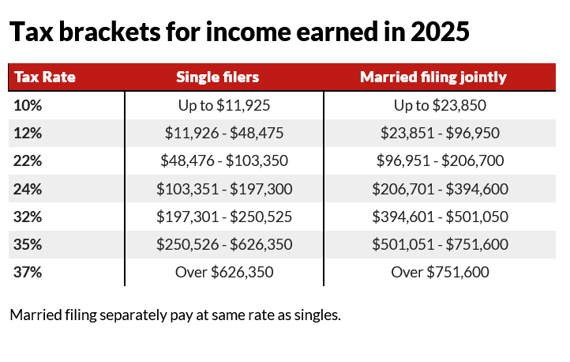
2025 Federal Income Tax Brackets and Rates
Single & Married Couples filing jointly
Head of household pay specific rates higher than single but not as high as joint

Slide 8
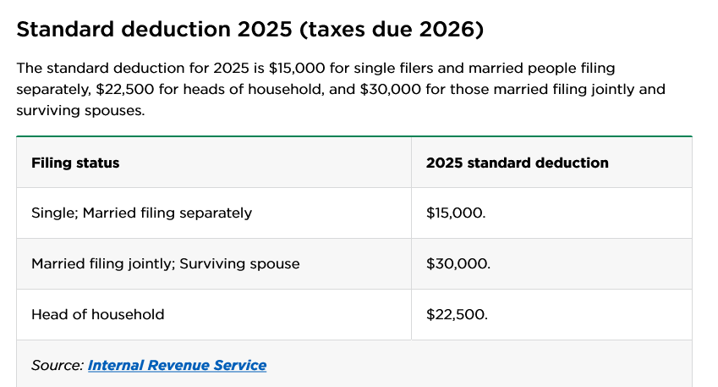
2025 Standard Deduction

Slide 9
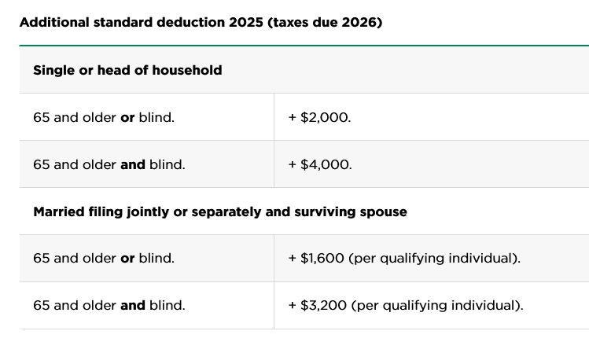
65 and older additional standard deduction
Total $17,000
Total $19,000
1-Total $31,600
2-Total $32,600
1-Total $32,200
2-Total $36,400

Slide 10
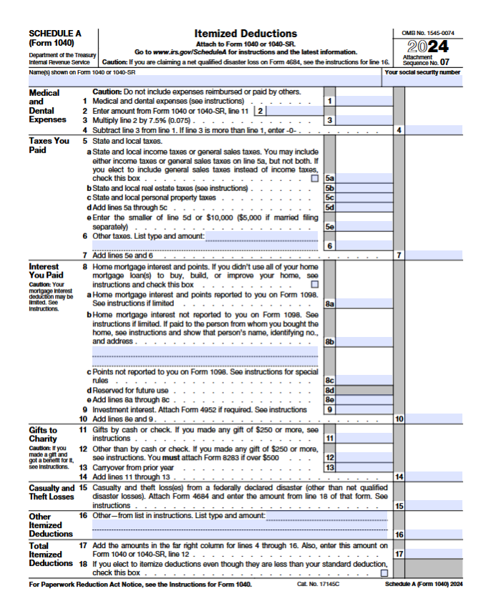


Slide 11

Standard deduction by filing status
Example 1: A couple both over 65 would have to have deductions over the threshold of $32,600 to itemize and receive an additional economic tax benefit.
  Under the threshold charitable gifts have
  no tax impact
Example 2: A single filer age 60 would have to have deductions over the threshold of $15,000 to itemize and receive an additional tax benefit.
  Under the threshold charitable gifts have
  no tax impact
Notes:
Here is a quick summary of the challenges in the new tax law.

Slide 12

Big Gifts / Small Effort
Tax Cuts and Jobs Act of 2017
Income Tax for 2024/2025
  Limit for cash charitable deductions is 60% of adjusted gross income. Limit for appreciated asset gifts 30% AGI.
  There are seven federal income tax rates and brackets in 2024/2025: 10%, 12%, 22%, 24%, 32%, 35%, 37%.
  Federal 2025 standard deduction will be $15,000 for single filers and $30,000 for married couples filing jointly.
  Your taxable income and filing status determine which federal tax rates apply to you, and how much in taxes you'll owe that year.

Slide 13
Big Gifts / Small Effort
Tax Cuts and Jobs Act of 2017
Estate and Gift Tax 2025
  Federal unified gift and estate tax exemption amount will be $13,990,000 or $27,980,000 per couple in 2025.
    Indexed each year, may end in 2026 unless renewed.
    A surviving spouse can effectively inherit the deceased spouse’s unused lifetime exemption amount, a concept often referred to as “portability” which can reduce or eliminate any federal estate tax on the surviving spouse’s death; in order to elect portability, the fiduciary must file an estate tax return, IRS form 706
  Federal annual gift tax exclusion will be $19,000 per person or $38,000 per couple in 2025.
    Indexed each year.

Slide 14
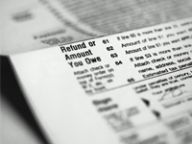
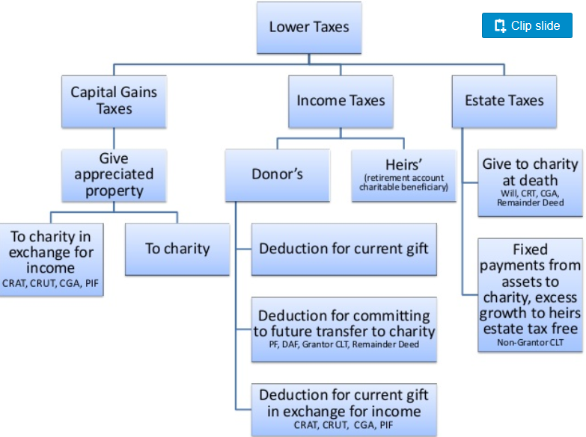
What gifts can do for you
Notes:
This is a simple chart showing the first benefit of charitable giving is the lowering of taxes
The government Federal and some states (not Pennsylvania) are our partners in giving since when you itemize your taxes and report charitable gifts you reduce your tax burden therefore your gifts costs less.
A $10,000 gift made in the 30% marginal tax bracket the donor receives a tax reduction of $3,000 therefore the cost of the gift “Out of Pocket” is only $7,000
We have many taxes
Income taxes on what you make.
Capital gains taxes on successful investments.
Estate taxes (MAYBE) when you die depending on how much you own. With recent changes fewer people fall into estate tax planning concerns.

Slide 15
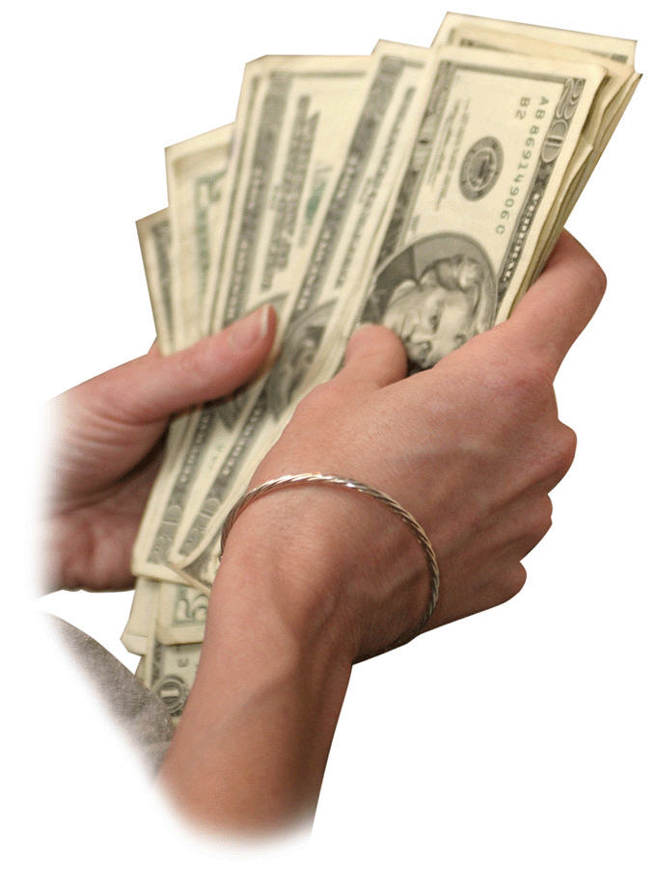
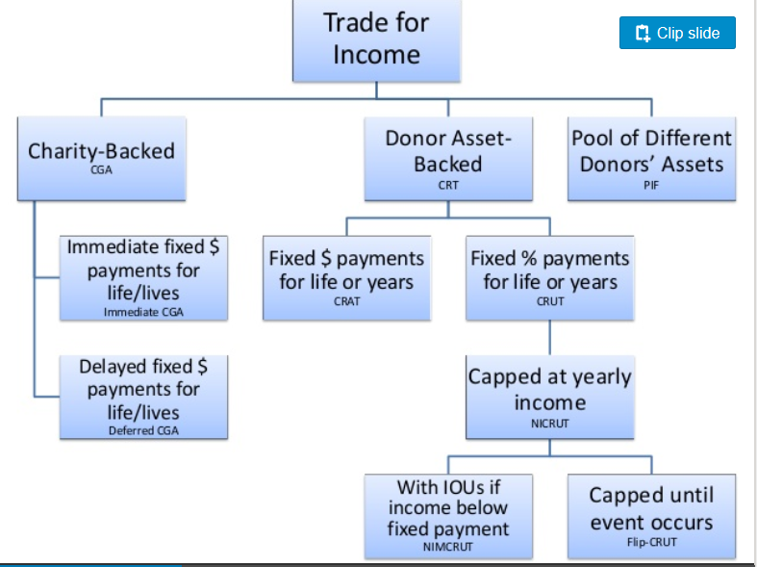
What gifts can do for you
Key: CGA – charitable gift annuity
CRT – charitable remainder trust, CRUT – Unitrust, CRAT Annuity trust,
NICRUT – net income makeup unitrust, Flip-CRUT
PIF – pooled income fund
Notes:
The other major benefit of charitable gifts is you may trade both income you earn and/or assets you own for income using tax advantaged plans.
There are many plans such as gift annuities backed by the charity
Charitable trusts backed by the gifted asset
And Pooled funds where your gift is invested with others. PLIFs have not been popular due to the fact they may only return income and income rates on investments have been historically low for the last 10 years since the recessions of 2007-2010.

Slide 16
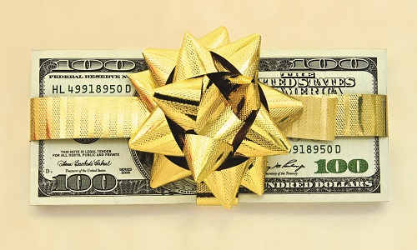
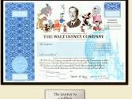
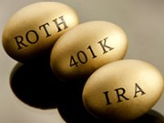

Effective giving strategies
Bunching gifts in certain years
  Every other year gifts
Appreciated asset gifts
  Capital gains tax not taxed
IRA rollover gifts
  No deduction but no tax on income
  Must qualify
  IRA gifts with income
Donor advised funds
  Gifts to reach over threshold deduction amount
Notes:
Effective giving involves a tax smart methods of decreasing income and capital gains taxes and creates a charitable deduction to qualify to itemize in certain cases.
Above is a summary of the major approaches.

Slide 17
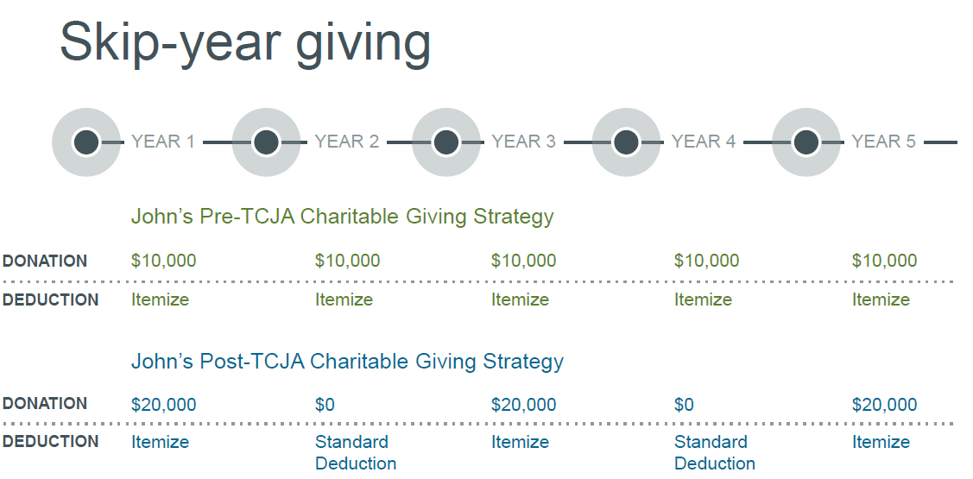
Effective giving #1
Bunching deductions
Skip year giving or bunching deductions will increase.
  Not a new strategy, have been used by seniors for years
Notes:
Retired individuals and many seniors have been using every other year gifts or bunching deductions for many years.
This was a more effective technique when the standard deduction amounts were lower but it is still in valid use today.
In stead of gifting $10,000, which may not qualify, a donor gives $20,000 every other year to qualify and uses the standard deduction amount in non-gift years.
To make up charitable support in the off gift years if the donor has a Donor Advised Fund for which they have already received a charitable deduction in prior years, the donor may remove assets from the DAF and gift to their favorite charity.

Slide 18
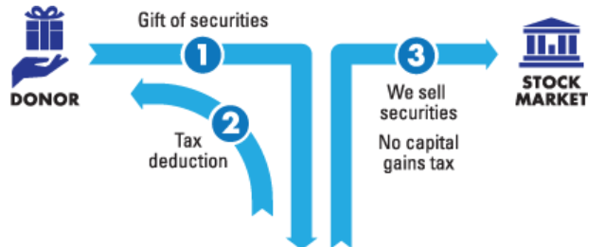
Effective giving #2
Give appreciated assets
Fair market value
Charity
Example: Sara has accumulated 1,000 shares of Apple stock over the last 5 years.
Her 1,000 shares are currently valued at approximately $230,000.
Her cost basis on the 10 shares of Apple she is gifting to charity is $60 per share.
She gets a deduction of $2,300 and avoids any tax on the $1,700 capital gains.
Notes:
Individuals who routinely gift cash should consider the major benefits of gifting appreciate securities.
A gift of appreciated assets to charity completely avoids capital gains taxes on the appreciation and in addition the donor receives a full fair market value charitable deduction.
A donor may select the total holding or may decide to gift only a portion of the holding as illustrated in this slide.
It is a BAD strategy to sell the stock today, incur the capital gains tax liability and gift the resulting cash.
The above example shows the many benefits of this strategy.
I often gift appreciated stock to make my contributions and if necessary round it up with cash to make my gift goal.

Slide 19

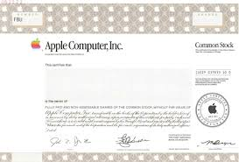
Effective giving #3
Give appreciated assets
Charitable swap strategy
1
Charity
3
2
Charity
No “wash sale” rule because this is gain property, not loss property
Notes:
Rather than donating cash to make a gift this donor looks at his portfolio and sees he has several shares of apple stock.
In place of the cash gift he gifts the stock and avoids any capital gains tax implications
He uses the original cash gift amount he was considering to repurchase the stock and therefore he has increased his cost basis in the stock and not reduce the amount of his holdings.
There is a 30 day waiting period to repurchase like kind securities sold at a loss.
Because this was gain property there is no 30 day waiting period.

Slide 20
Effective giving #4
Qualified charitable distributions “QCD”
A qualified charitable distribution (QCD) can be a great way to reduce required minimum distributions (RMDs) and optimize the tax benefits of giving.
    Both regular IRA accounts and Roth IRA accounts are eligible, IRA check books
    RMD under Secure Act is age 73 (2025)
Charity must be eligible
Individual must be 70½ or older on the date of contribution
    QCD will qualify for the Required Minimum Distribution (RMD) requirements of IRAs
$108,000 limit (2025)
    $216,000 from couple with separate accounts
Not allowed - transfers from other accounts 403b,401k, etc.
Notes:
The slide lists the basic requirements for an individual to be eligible and for a charity to receive a rollover from a IRA or Roth IRA account. It also lists those retirement plans which are not eligible for the transfer.
It is important to note the individual must be 701/2 or older on the day the gift is made to qualify for this advantageous tax treatments.

Slide 21
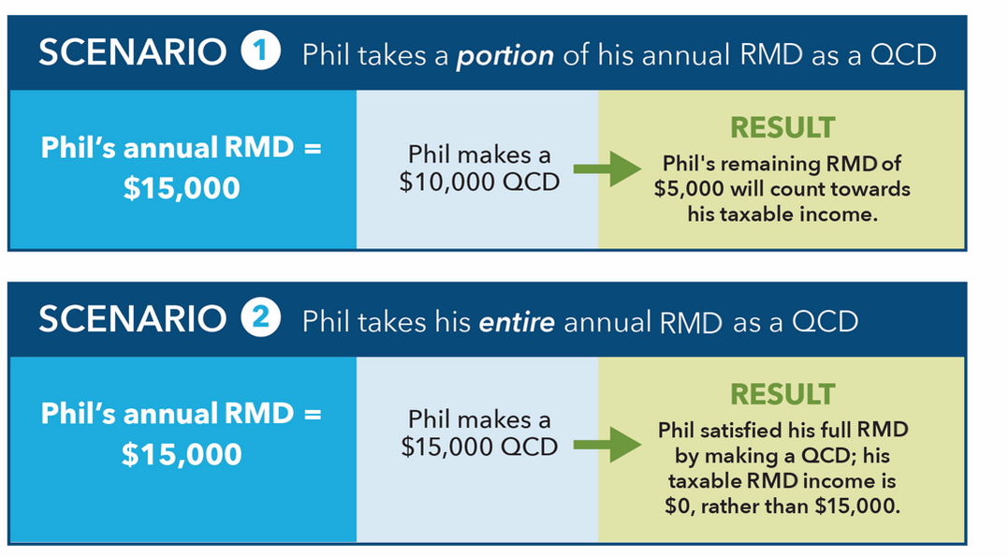
Effective giving #4
Qualified charitable distributions “QCD”
Note: No charitable deduction
1) Tax saving 24% bracket saved $2,400, 2) saved $3,600
Notes:
Here is an example of a $15,000 required minimum withdrawal by Phil from his IRA account.
In scenario 1 Phil makes a $10,000 Qualified Charitable Distribution from his IRA and uses the remaining amount for living expenses.
It should be noted Phil could take our larger distribution amounts at any time during any year his IRA account has assets. An increased withdrawal amount in any year does not count toward the next year Required Minimum Distribution amount which is always based on the IRA owners current age, the account value and the age of the spouse beneficiary, if any.
In Scenario 2 Phil makes a gift to one or more charities of his entire MRD and pay no taxes on the distributed amount.
I have noted the amount of taxes saved in both #1 and #2.

Slide 22
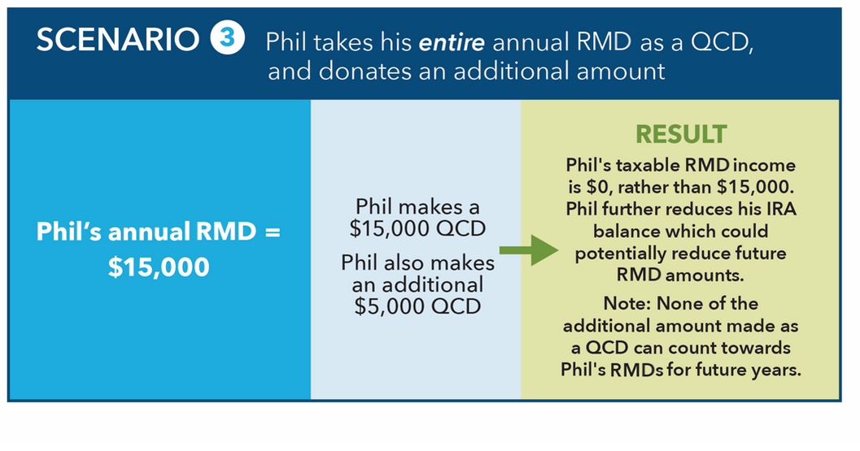
Effective giving #4
Qualified charitable distributions “QCD”
Note: No charitable deduction in this case but if Phil used appreciated assets or cash
he would receive additional $5,000 deduction but he must itemize to get
the government bonus for being charitable. If he does not itemize this is still a tax
smart approach.
Notes:
Since there are no taxes on the QCDs there is no charitable deduction to be added to the silos mentioned before (SALT, Interest, Gifts) so there is no qualification amounts to itemize.
Phil could make gifts of other assets to charity which may qualify to be itemized providing the standard deduction threshold is crossed.

Slide 23
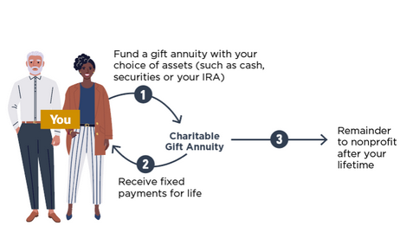
Effective giving #5
First: How a Charitable Gift Annuity works
Simple to understand
Simple to arrange
Modest gift amounts
Multiple contracts
Guaranteed payment
Lifetime payments
Start with cash, stock, real estate, QCD
No estate tax

Slide 24
Effective giving #5
QCD for life income
A qualified charitable distribution (QCD) can be a great way to reduce required minimum distributions (RMDs) and optimize the tax benefits of giving or receive a life income from Charitable trusts or Charitable gift annuity.
One-time transfer only
Beneficiary either donor, spouse or donor and spouse
$54,000 limit for 2025
Minimum 5.00% payout rate
No charitable deduction = no tax on RMD withdrawal
Single life CGA for age 71 is 6.4%
Two life CGA for ages 81/69 is 5.9%
Payments taxed at ordinary income rates
Notes:
The slide lists the basic requirements for an individual to be eligible and for a charity to receive a rollover from a IRA or Roth IRA account. It also lists those retirement plans which are not eligible for the transfer.
It is important to note the individual must be 701/2 or older on the day the gift is made to qualify for this advantageous tax treatments.

Slide 25
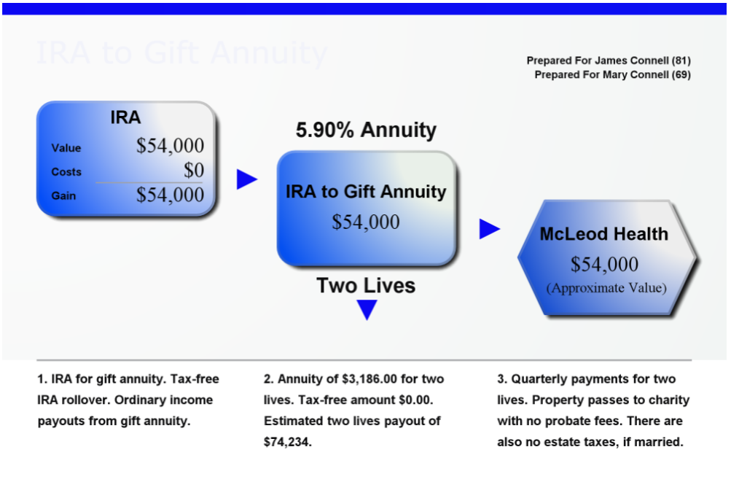
Effective giving #5
QCD for life income

Slide 26
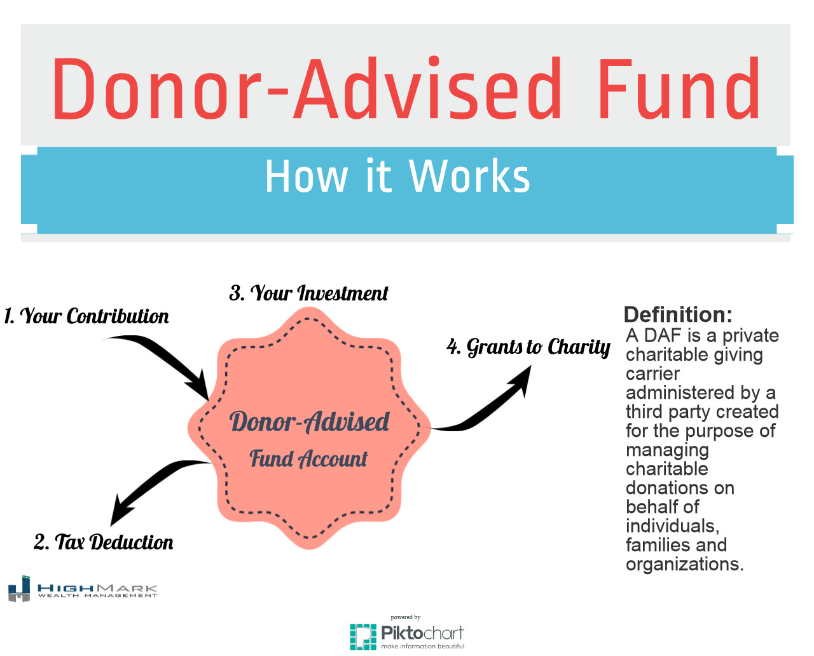
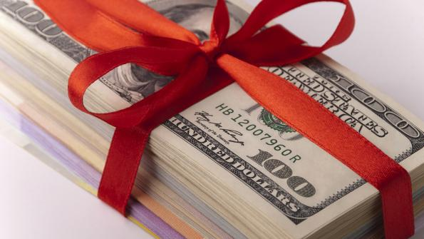
Effective giving #6
Donor advised funds “DAF”
Notes:
There are many local community foundations and commercial national foundations that sponsor donor advised funds. The largest is the Fidelity Gift Fund.
Cash or appreciated assets may be donated to a DAF, receive an immediate income tax deduction and gifted in future years to the donors charity of choice.
There are many benefits of using a DAF for your philanthropy, which are listed on the following slide.
I use a DAF to increase my giving over the standard deduction threshold to qualify to itemize my deductions.
In 2018 this strategy may or may not be used for my personal giving.

Slide 27
Effective giving #6
Donor advised funds “DAF”
Give cash now
Maximize charitable deduction in year of your gift
Gift appreciated assets to save capital gains taxes
Gift complex assets
Front load gifts in high tax years
Grow your fund tax-free & determine investments
Time future gifts for maximum charitable impact
  No “quid pro quo” benefits
Can make gifts anonymously
Less expensive alternative to creating a private foundation
Notes:
How a DAF may be sued for effective giving.
The growth of the DAF account is an additional benefit and commercial funds have generally lower charges and fees than locally managed funds. Locally managed funds have a significant impact on local needs and can identify area of greatest need while with commercial fund the donor or the successor director of the fund must decide on the charity to be supported.

Slide 28
Effective giving #7
Personal Endowment Funds
Give cash or appreciated assets now to charity
Maximize charitable deduction in year of your gift
Work with charity to establish a structured investment account which pays guaranteed lifetime income stream based on age of covered life
Uses insurance company variable annuity with guaranteed withdrawal benefit with step up payments
Donor – Charity -Variable Annuity – Income - Charity
Notes:
How a DAF may be sued for effective giving.
The growth of the DAF account is an additional benefit and commercial funds have generally lower charges and fees than locally managed funds. Locally managed funds have a significant impact on local needs and can identify area of greatest need while with commercial fund the donor or the successor director of the fund must decide on the charity to be supported.

Slide 29
Effective giving #7a
Personal Endowment Funds
Personal Endowment Account Guaranteed Annual Withdrawal Payment
Age 65-74 | Age 75-80 | Age 81+
5.15% | 5.40% | 5.40%
Commercial insurance variable annuity option
Minimum gift amount $25,000, additions permitted

Slide 30
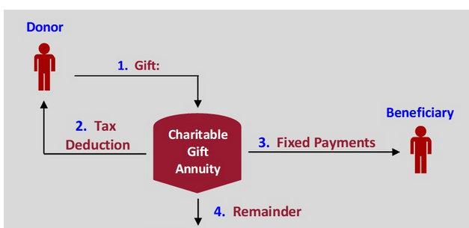
Effective giving #8
Gift annuity to increase income & decrease taxes
Helps secure the future of the charity and support its mission
Provides benefits to both donor and charity
Charitable gift annuities offer attractive rates and tax-free payments
Funded with cash or appreciated assets
America’s most popular life income agreement
Simple to establish

Slide 31
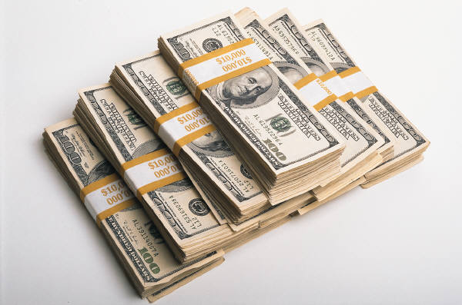

Effective giving #8
Gift annuity to increase income & decrease taxes, 2025 payment rates
Single Life
Age of Donor
60
65
70
75
80
Payment Rate
5.20%
5.70%
6.30%
7.00%
8.10%
Two Life
Age of Donors
60/60
65/65
70/70
75/75
80/80
Payment Rate
4.70%
5.00%
5.50%
6.20%
6.90%

Slide 32
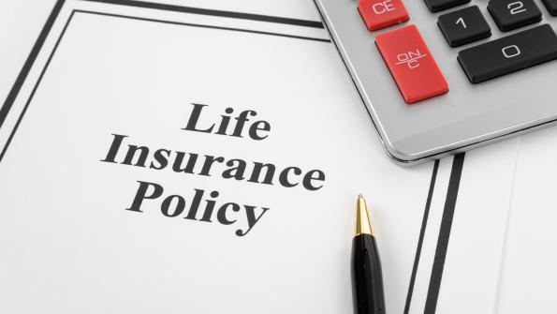
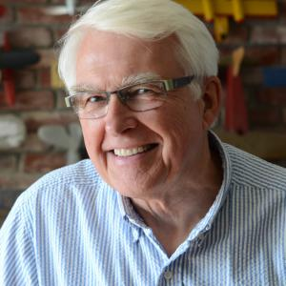
Effective giving #9
Donor purchased life insurance
Increase value of ultimate gift
Donor male aged 62 in a high tax bracket
Establishes a new $50,000 life insurance policy
Charity is owner and beneficiary
Donor makes annual premium payments to charity
Fully deductible at premium cost
Cost: $5,963 per year for 5 years
Can fund premium with cash or securities

Slide 33

Effective giving #9a
Donor owned life insurance
Increase value of ultimate gift
Donor owns life insurance that is no longer needed for the original intended purpose
Donor has been making payments for 20 year with more payments due
Policy has cash value
Donor gifts policy to charity
  Owner changes beneficiary to charity
  Agent changes ownership
Charity uses policy appraised cash value and issues a tax receipt to donor to reduce taxes
Option 1: Donor continues policy payments
Option 2: Charity converts policy to paid up status, no payments due
Option 2: Charity uses its funds to pay premiums

Slide 34


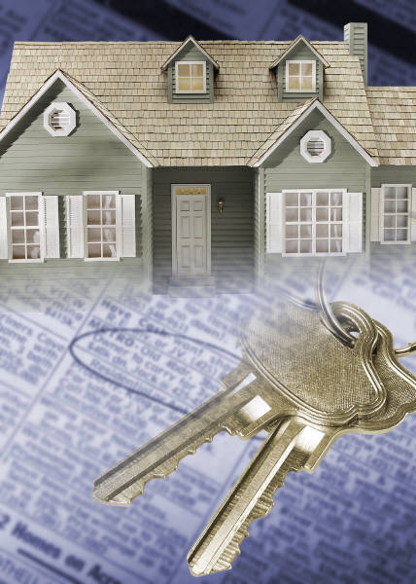
Effective giving #10
Gifting real estate for life income
Personal residence
Vacation home
  Non-rental
  Rental property
Commercial property
  Used in taxpayers' business
    Motels, recreational parks, farms,
    office buildings, golf courses,
    mobile home parks, and more
Condominium
Farmland
Investment real estate
  Apartments, office buildings
Raw land

Slide 35

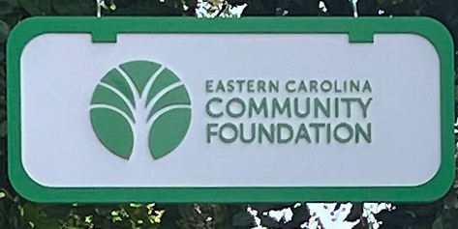

Thank You
Tax Smart Giving

